Slide 1
The Problem Statement:
The railway network is the backbone of transportation, connecting millions of passengers daily. With a growing number of travelers, the company collects vast amounts of data—reservations, payments, and cancellations. However, despite having this data, decision-making remains reactive rather than proactive.
What is the age and gender distribution of passengers?
Who are the top 10 frequent travelers?
Which passengers have the highest spending on tickets?
What are the top 5 busiest train routes?
Which trains have the longest travel duration?
Which month has the highest number of ticket bookings?
How many reservations get confirmed vs. on the waiting list?
What is the percentage of last-minute bookings (less than 24 hours before departure)?
What is the total revenue earned per train type?
What payment mode is used the most by passengers?
What is the cancellation rate per train type and route?
What are the top 3 reasons for cancellations?
What is the average refund amount given per cancellation?

Slide 2
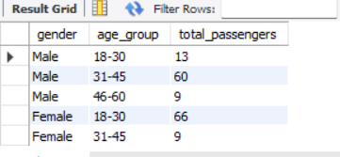
Q.1 -- What is the age and gender distribution of passengers?
Insights:
Insights:-
1. There are 66 female passengers in this age group compared to 13 males.
This suggests that young female travelers prefer trains more than males in this category.
2. The 31-45 age group has 60 male passengers, the highest for males.
This could indicate that working professionals in this age range travel frequently by train.
3. Only 9 female passengers in this category compared to 60 males.
This could suggest a decline in female train travelers after early adulthood due to Shift to private transport, work-from-home, or other travel preferences.

Slide 3
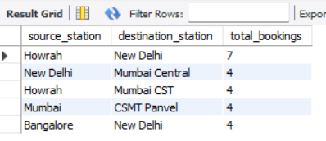
Q.2 -- What are the top 5 busiest train routes?
Insights :-
Howrah to New Delhi is the most popular and busiest route According to the data.
2. New Delhi To Mumbai Central
Howrah To Mumbai CST
Mumbai To CSMT Panvel
Bangalore To New Delhi
This suggests that these routes are consistently in demand but less than Howrah to New Delhi.

Slide 4
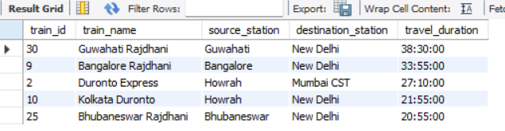
Q.3 -- Which trains have the longest travel duration?
Insights :
This suggests that this trains covers a significantly long-distance route with long duration.

Slide 5

Q.4 -- Which month has the highest number of ticket bookings?
Insights: -
March has the highest number of ticket booking according to data.

Slide 6
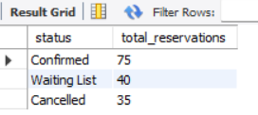
Q.5 -- How many reservations get confirmed vs. on the waiting list?
Insights:-
Out of 150 total reservations (75+40+35), 75 are confirmed, meaning a 50% confirmation rate. This suggests that only half of the bookings get confirmed, possibly due to seat availability issues.
2. 40 reservations (27%) are on the waiting list. This indicates high demand and possibly overbooking of trains.
3. 35 reservations (23%) were canceled, which is a significant number.
This could be due to passengers finding alternative travel options, delays, or high waiting list numbers.

Slide 7
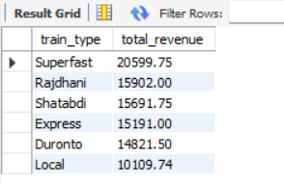
-- What is the total revenue earned per train type?
Insights:-
Superfast trains contribute the highest revenue (₹20,599.75), indicating high passenger preference and pricing power.
These trains are likely faster and more efficient, attracting passengers willing to pay more for speed and convenience.
2. Local trains have the lowest revenue (₹10,109.74), which is expected as they cater to short-distance commuters at lower fares.
Despite the lower revenue, they serve a high volume of passengers and are essential for urban mobility

Slide 8
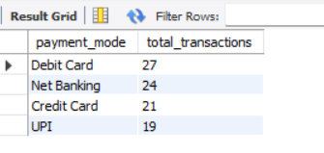
-- What payment mode is used the most by passengers?
Insights:-
According to this data we get, the most of the transactions are done using debit card, net banking credit card and UPI.
This means most of the people prefer online option for transactions option.

